Slide 1

SOLID Principles
Single Responsibility
Open close

Slide 2
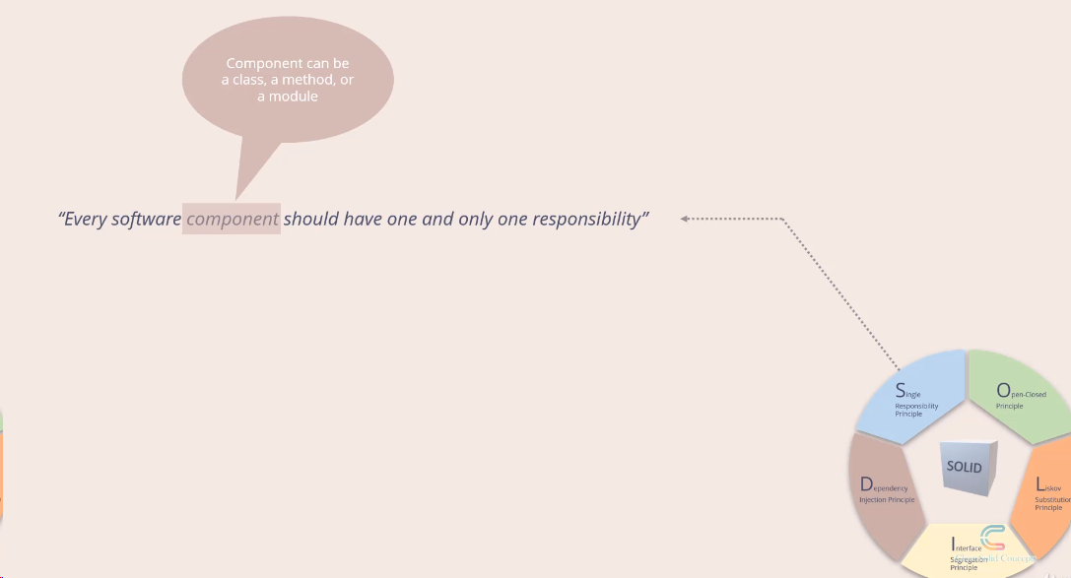
Single responsibility

Slide 3
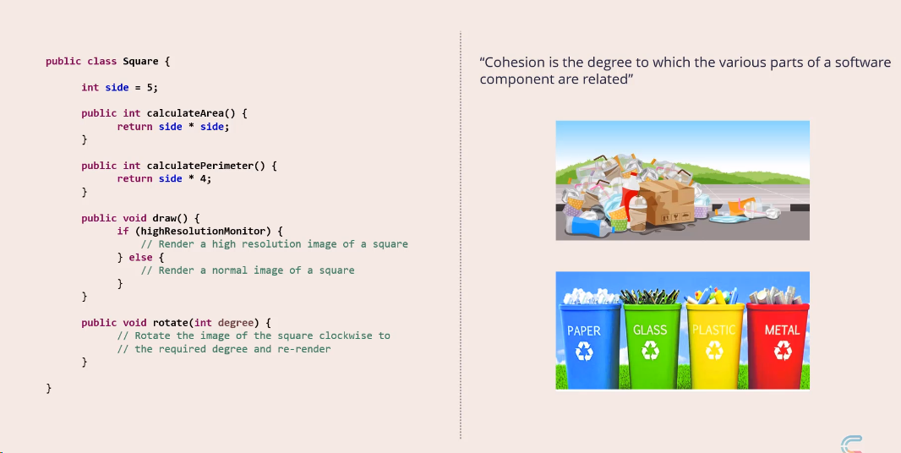
Cohesion

Slide 4
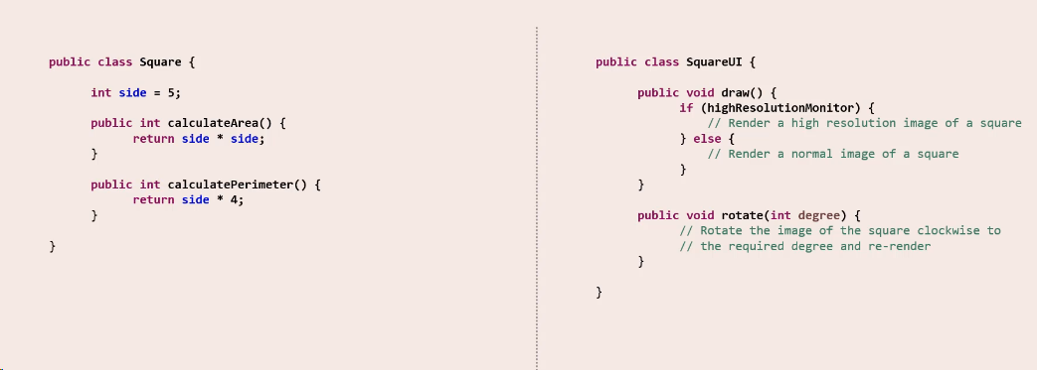
Cohesion

Slide 5
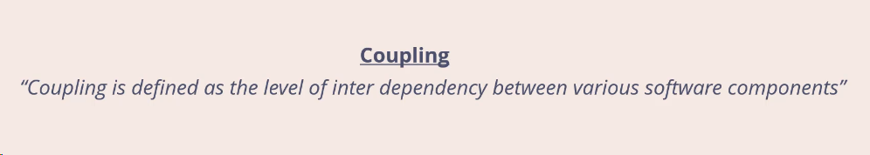
Coupling

Slide 6
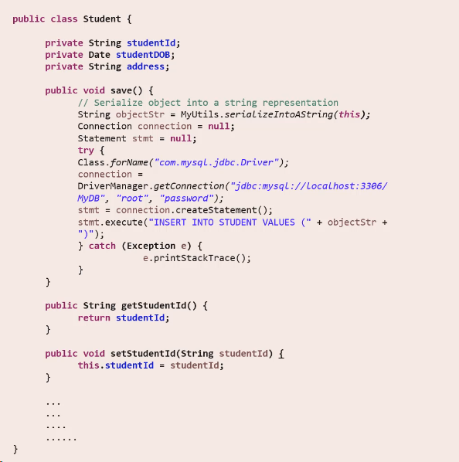
Coupling

Slide 7
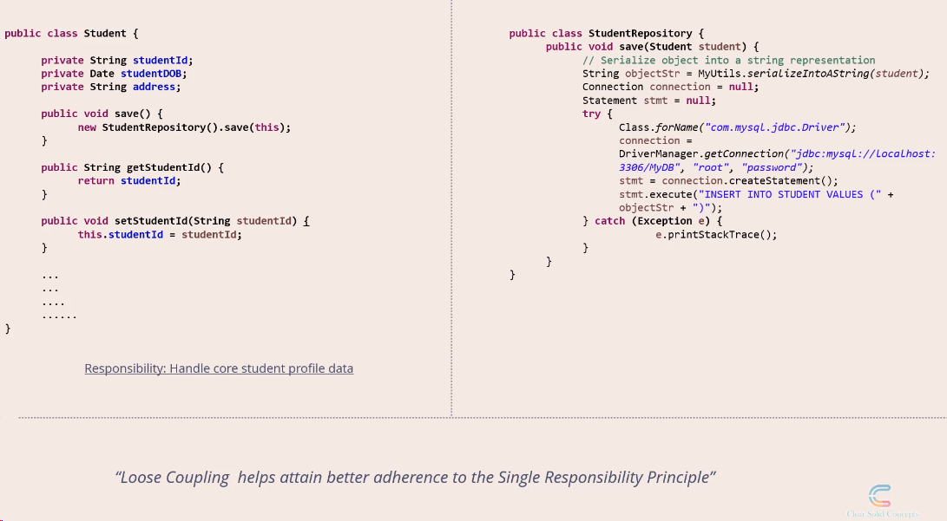
Coupling

Slide 8
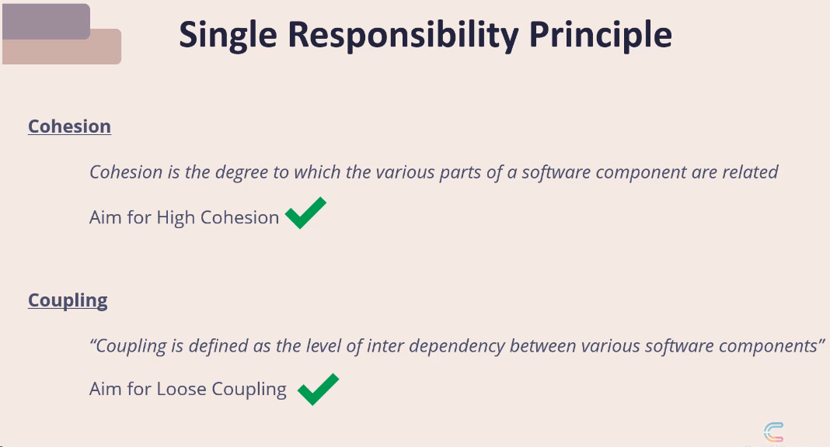

Slide 9
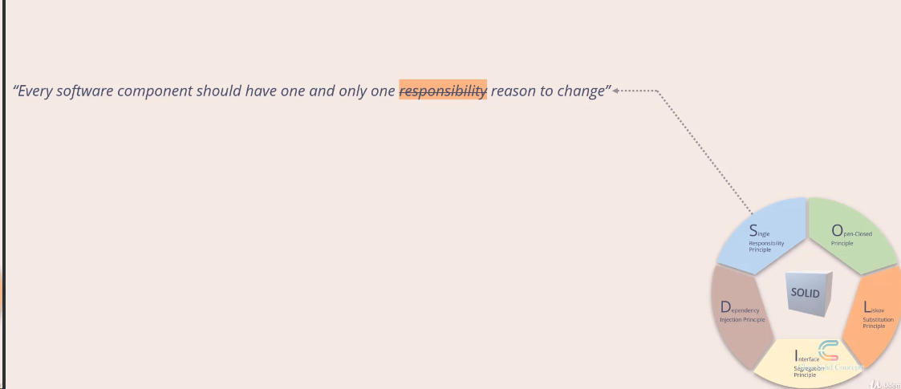
Reason to change

Slide 10
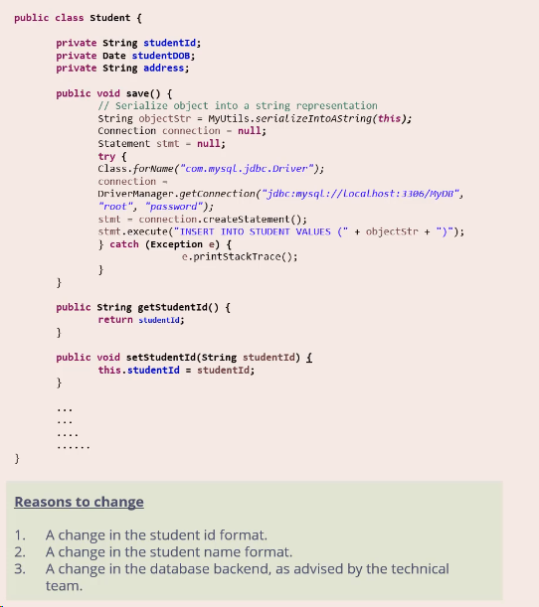
Lets remove reason to change

Slide 11
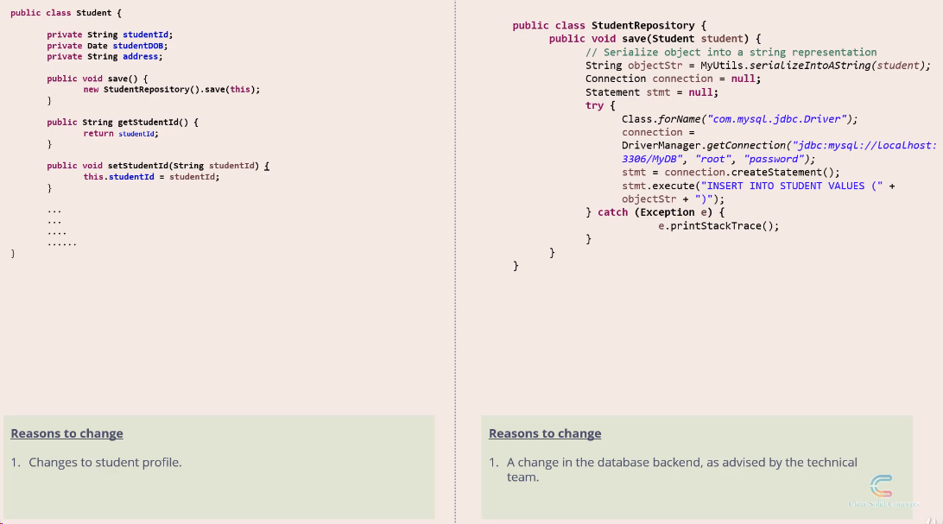
if the reason is closely related to one and another, you can combine

